Slide 1
Best place to live or buy house in United States
Niche.com
Moonsung Kang

Slide 2
Niche.com
Niche.com is a website that helps us to learn about the schools and neighborhoods in U.S.
The web site is well organized and there are a lot of resources to web scrape.
The 2017 top places to buy house ranking provides a comprehensive assessment of the overall livability of an area. This grade takes into account several key factors of a location, including the quality of local schools, crime rates, housing trends, employment statistics, and access to amenities in an attempt to measure the overall quality of an area.

Slide 3
Data from the website
They use the most up-to-date data available from dozens of public data sources including the Department of Education, U.S. Census, IRS , NCES, College Survey and FBI , etc.

Slide 4
Columns
State | City | Area_Feel | Population | Associate_ Degree | Bachelor_ Degree | Master_ Degree | Jobs Level | Median_ Home_ Value | Median_ Rent
Cost_of_ Living | Crime_Safty | Diversity | NightLife | Children_ percent | Public School_level | Outdoor_ Activity | Weather | Review_ ratings | Numberof_ reviews
Scrapy
Plotly

Slide 5
My SCV File and My goal
From the data I collected,
I was able to see the highest value in each column.
I was able to compare columns by columns.
My goal is to see the trends and find what factor changes the price of the housing market the most.
Also, find some insights in each area for potential different business types.
Moreover, find underpriced housing market from the data.

Slide 6
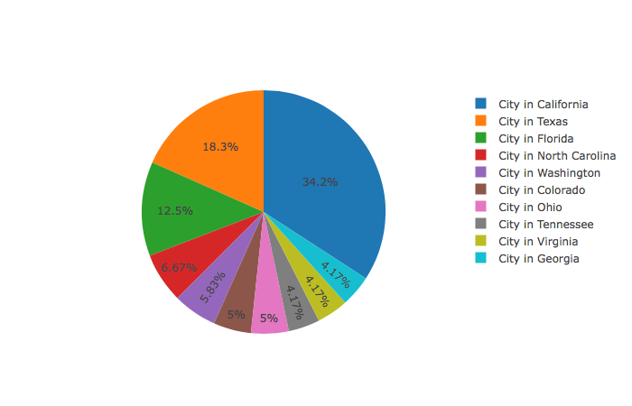
Most popular States
This pie-chart shows California
State is the most popular state among all.
34.2% of the data that was collected are cities in California.
As we can see, many popular States are in warmer area.

Slide 7
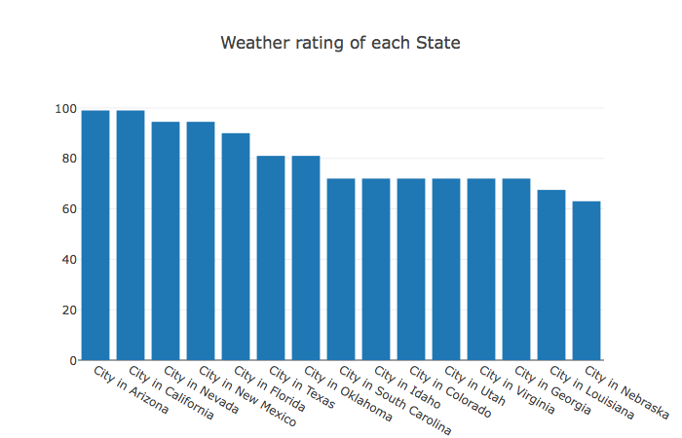
Weather
This is a bar-chart of weather ratings.
The rating was from 0 to 100.
0 as not a good weather
100 as very good weather
This bar chart is relevant to the pie chart because the top rated states from pie chart were also picked in this chart.

Slide 8
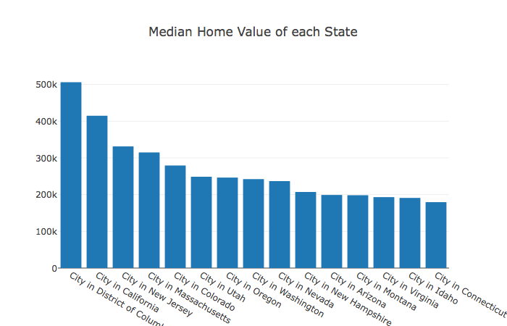
Median price of house
Top Median Home Values
California
New Jersey
Massachusetts
Colorado
Utah
Oregon
Washington
Nevada
New Hampshire
Arizona
Montana
Virginia
Idaho
Connecticut

Slide 9
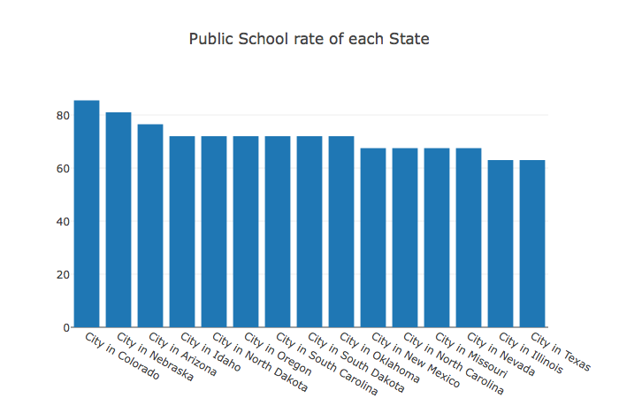
Public school and house price
Top picks from Median price of house
Colorado < 300k
Oregon =250k
Nevada < 250k
Arizona = 200k
Idaho < 200k

Slide 10
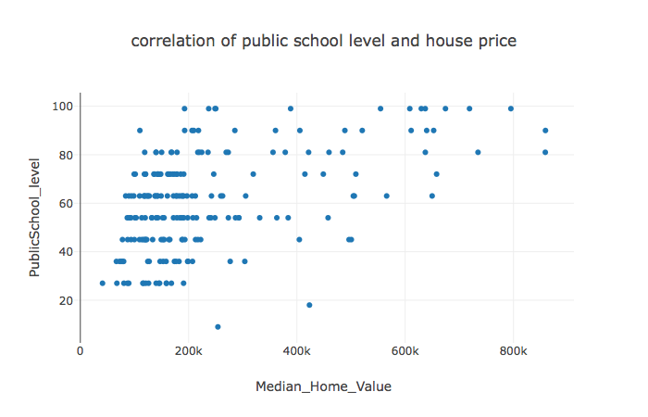
Public school and house price
As we can see, There are many house prices under 300,000 but,
As public school school level goes up, home value also goes up

Slide 11
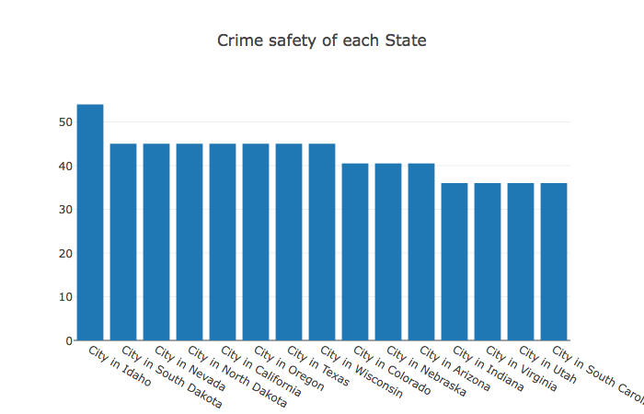
Crime Safety Rating
Overall, Crime safety rate in U.S was not so good.
Highest rate was about 54 out of 100.
But, top picks from previous graphs has high crime safety ratings.
According to the scatter plot I did it before, there was no significant correlation between price and crime safety level.

Slide 12
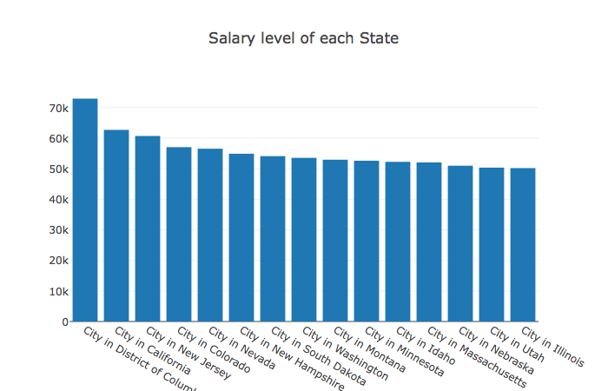
Salary and House Price
Top Salary States
California
New Jersey
Colorado
Nevada
New Hampshire
South Dakota
Washington
Montana
Minnesota
Idaho
Massachusetts
Nebraska
Utah
Illinois

Slide 13
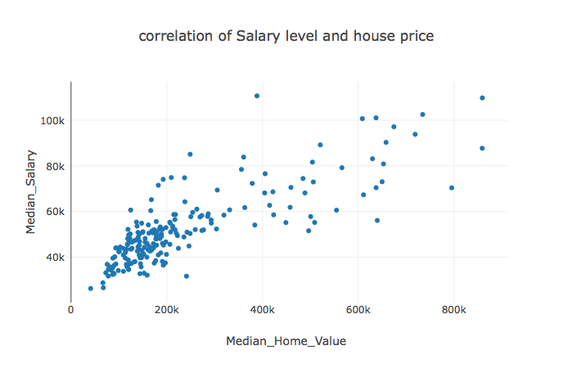
Salary and House Price
We can see that, there is correlation between salary and the price of houses.
When average salary goes up, home value also goes up

Slide 14
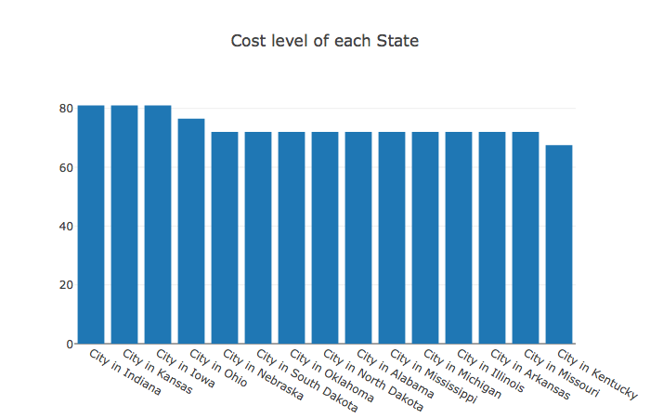
Cost of living
This is top states that have good cost of living
Higher the number shows good cost of living.
Most of the States are in mid U.S

Slide 15
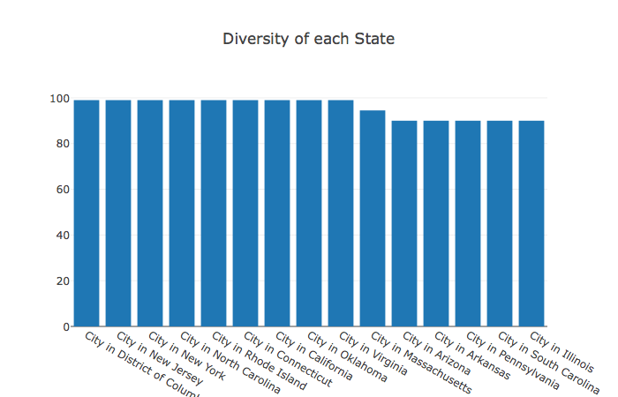
Diversity

Slide 16
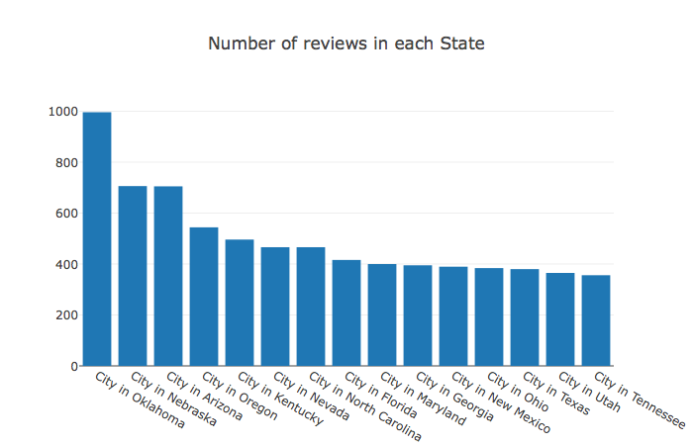
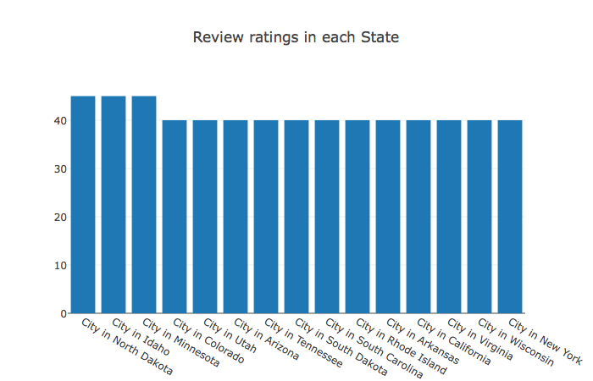
Reviews
Mid U.S States are very popular with good ratings

Slide 17
Conclusion
I believe it will be good choice to buy house in mid U.S.
The reasons are
They have good cost of living
They have higher crime safety rating
Lower house price
The salary range is still in high bracket
Good public school level
Good weather
I believe mid U.S house market is underpriced and because they have low diversity rates, it could be interesting to bring foreign item.

